Slide 1

Analysis of optimization of string searching algorithm using BWT & FM index
Milan Knezevic
2019/3169

Slide 2
Memory consumption
If t is size of the original text (excluding terminating character $) and n is number of distinct characters that occur in that text:
L – stores t + 1 characters
F – stores n integers
Suffix array – stores t + 1 integers. It can be downsampled.
Tally – stores (t + 1) * n integers. It can be downsampled.
In reality, even more memory is necessary because of different implementation of data structures in different programming languages.

Slide 3
Testing parameters
Chromosomes:
Coffea arabica (coffee) chromosome 1c, patterns: ATGCATG, TCTCTCTA, TTCACTACTCTCA
Mus pahari (shew mouse) chromosome x, patterns: ATGATG, CTCTCTA, TCACTACTCTCA
Homo sapiens (human) chromosome y, patterns: GGAGTC, CAGCCCCACGGA, AGCGCC
Suffix array downsampling factors: 1, 4, 16, 64, 256
Tally downsampling factors: 1, 8, 32, 128, 512

Slide 4
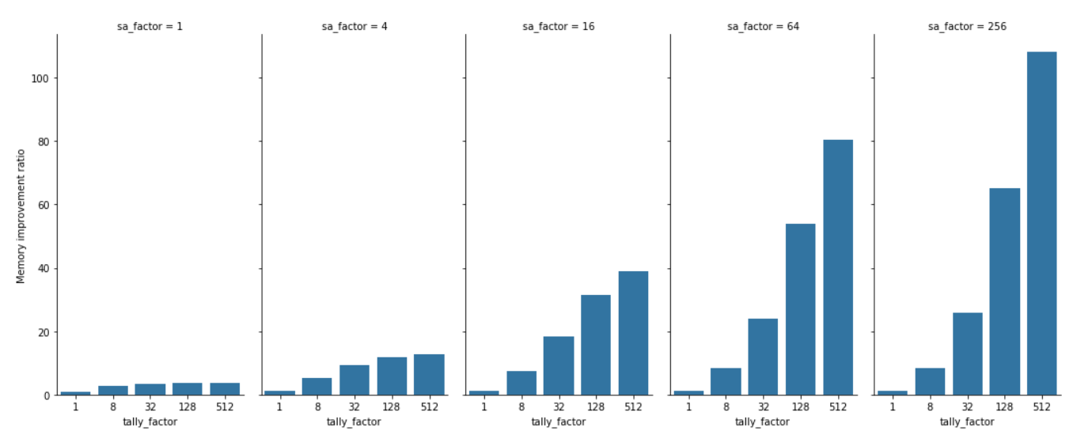
Memory improvement ratios
With the increase of suffix array downsampling factor, the increase in tally downsampling
factor results in bigger memory improvement.

Slide 5
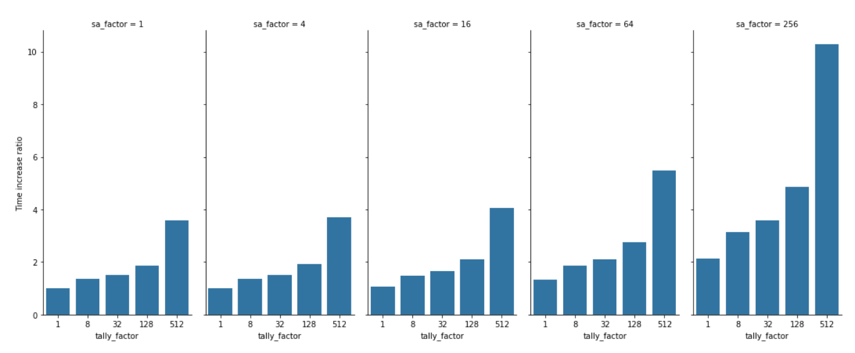
Time increase ratios
With the increase of downsampling factors, execution time increases slowly.

Slide 6
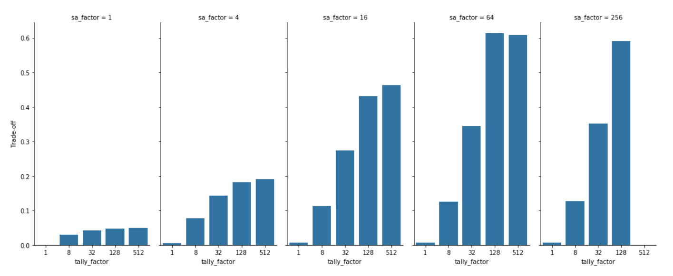
Trade-off (harmonic mean of normalized improvement ratios)
Optimum has 2.75 times bigger executon time and consumes 53.92 times less memory.

Slide 7
Thank you!
GitHub repository: https://github.com/iknezevicmilan/gi-projekat

